Slide 1
Sorting Visualizer
OOLT.ICT.20202.Team10
Phan Huy Thang - 20184305
Nguyen Phu Truong - 20184319
Ngo Viet Tung - 20184326

Slide 2
Members & Assignment
Phan Huy Thang:
Analyze and design use case and class diagram.
Develop features: data input, help dialogs, review PR.
Contribute to write report and slide making
Making video presentations.
Nguyen Phu Truong:
Analyze and design use case and class diagram.
Develop features: sort algorithm, manipulate sorting process.
Contribute to write report and slide making.
Ngo Viet Tung:
Analyze and design use case and class diagram.
Develop features: sort algorithm, statistics info.
Contribute to write report and slide making.

Slide 3
Problem statements
Array is the most basic structure of computer science. Most operations as well as other data structures are built and performed on array. Sorting is one of it. However, in practical we can implement sorting algorithms without imagine what it looks like step by step. This project will help you more understand the sorting algorithm by visualize step by step the sorting process.
The project currently support 3 algorithms namely: bubble sort, quick sort, and insertion sort.

Slide 4
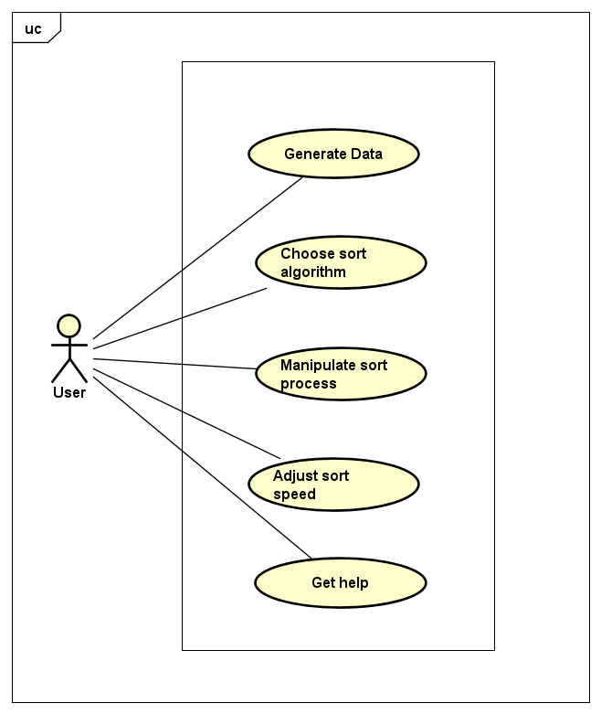
Use-case diagram
Sorting Visualizer mini-project

Slide 5
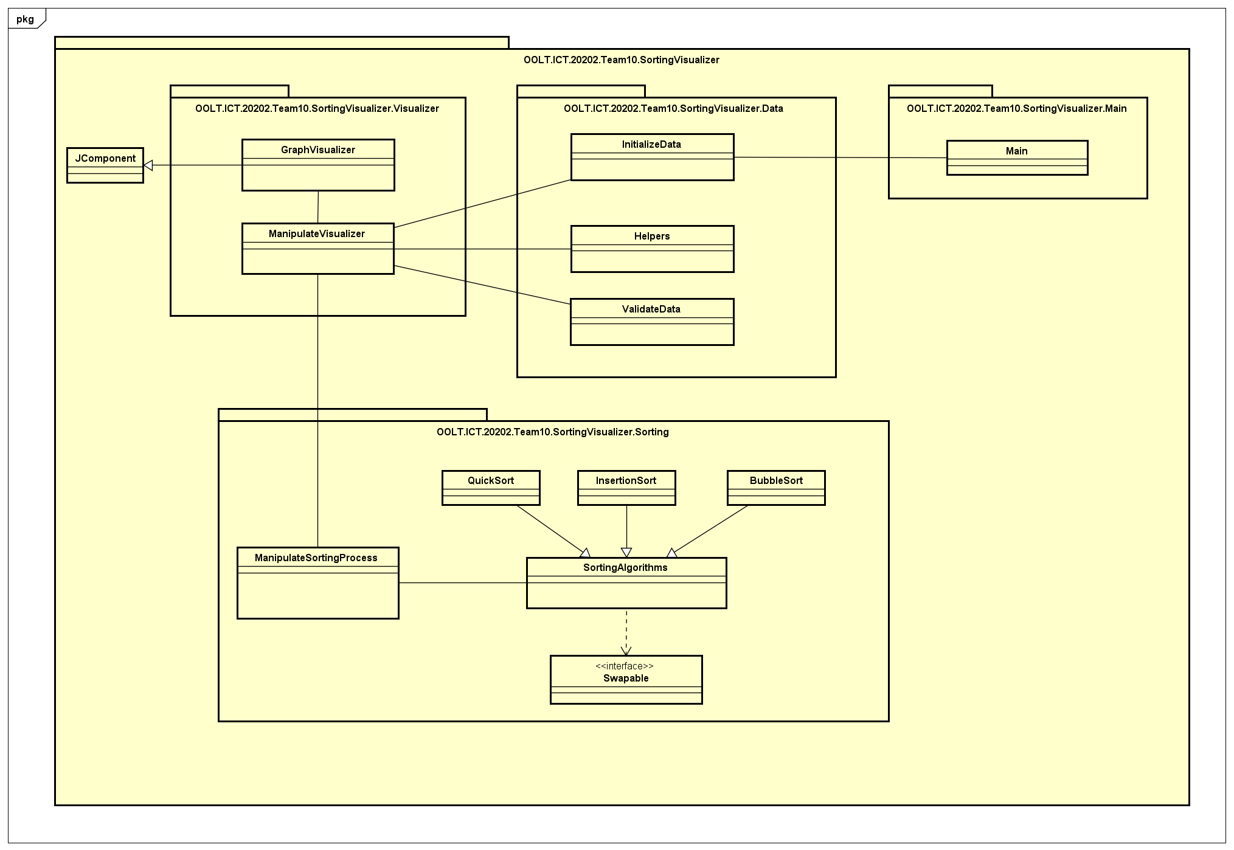
Class diagram
General overview

Slide 6
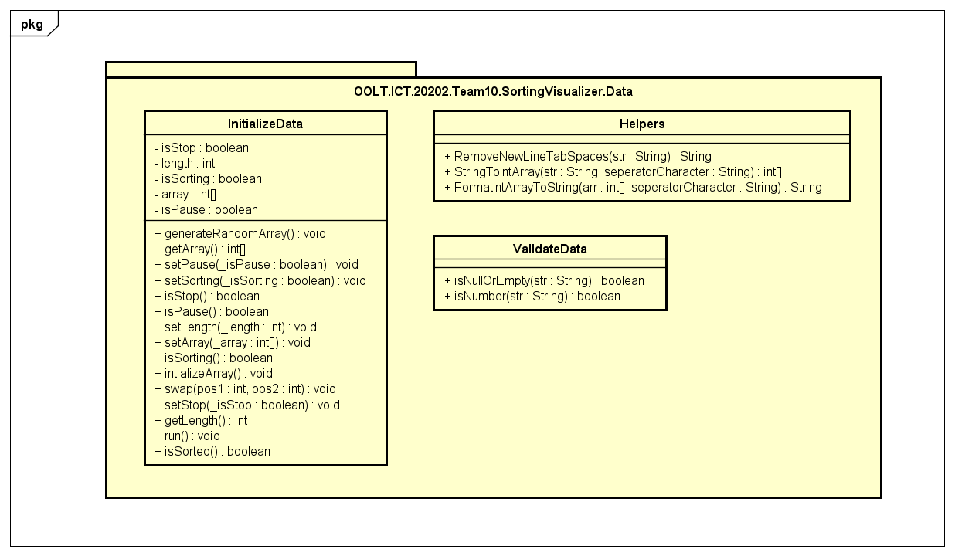
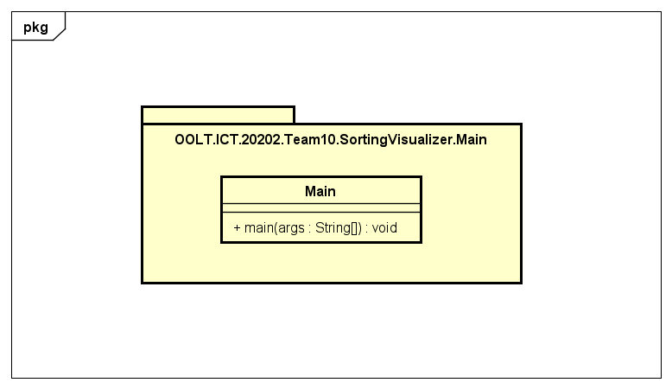
Class diagram
In package Data and Main

Slide 7
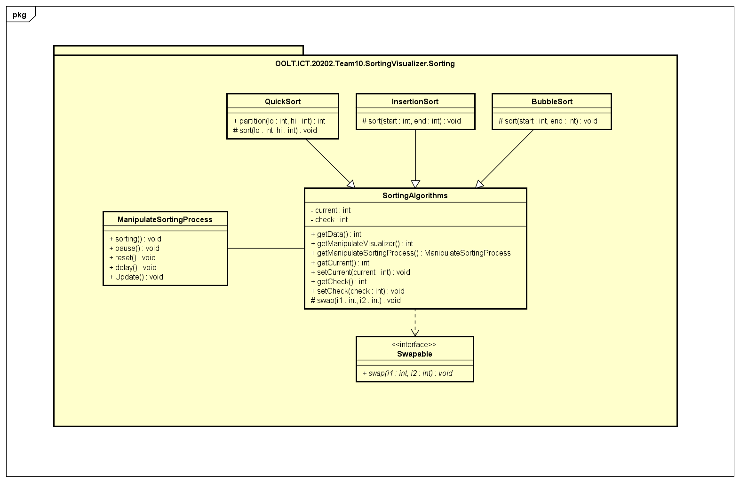
Class diagram
In package Sorting

Slide 8
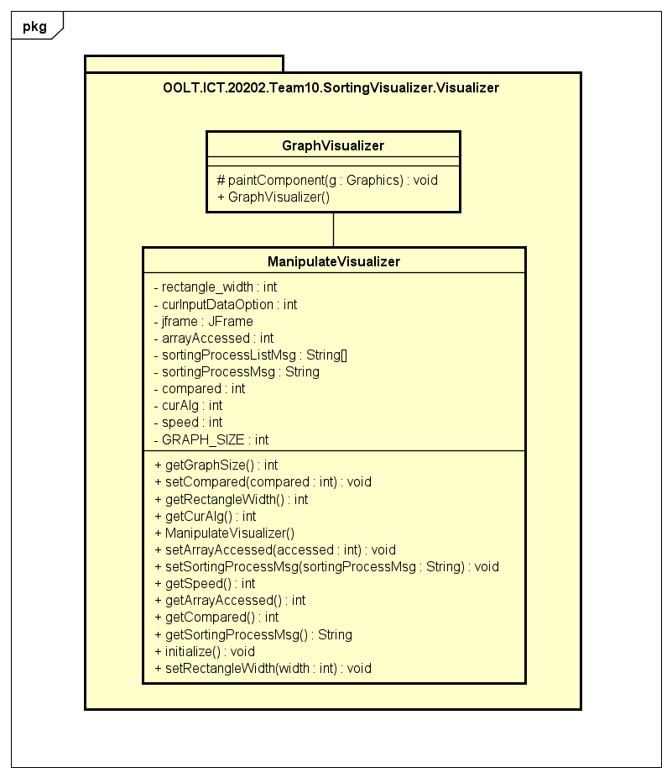
Class diagram
In package Visualizer

Slide 9
OOP techniques
Inheritance:
Class SortingAlgorithms inherit from interface Swapable.
Polymophism:
Classes QuickSort, InsertionSort, BubbleSort extend class SortingAlgorithms override method sort.
Class GraphVisualizer override method paintComponent in class JComponent.

Slide 10
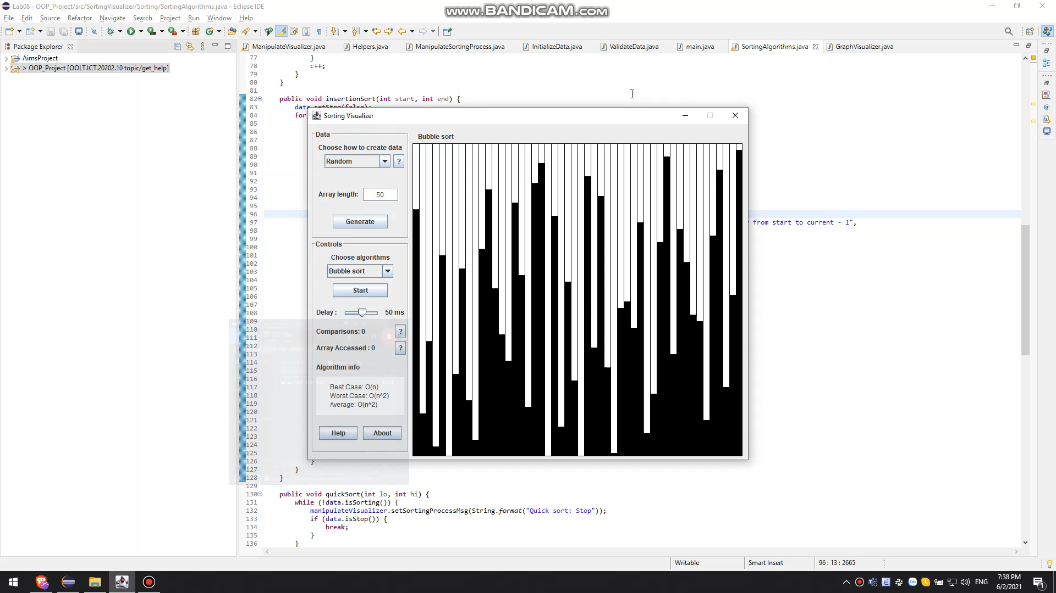
Demo

Slide 11

Thank you for listening!
OOLT.ICT.20202.Team10

